Slide 1

BANK Loan ANALYTICS
Team members:
Ms. Rutuja Mahadeorao Lokhande
Mr. Abhijeet Satyavan Tekawade
Ms. Varshasree Pasupuleti
Mr. Mahesh Sahu
Mr. Bugidi Pavan Sai
Ms. Charul Baghmar

Slide 2
KPIs & Observations
1
2
Recommendations
Index
Challenges
3
4
Learning

Slide 3
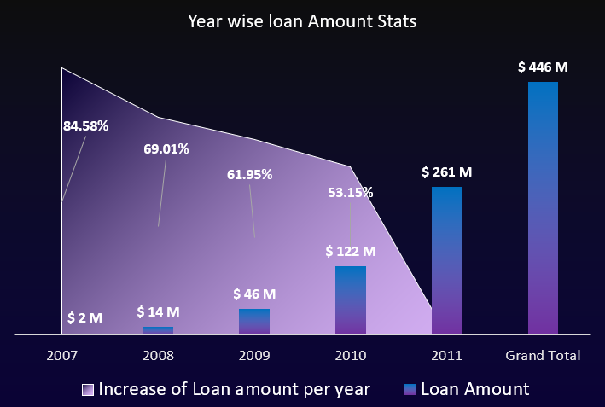
KPI 1: Year wise Loan amount Stats
OBSERVATIONS
Total loan amount is 446M
Highest loan Amount is in 2011 which is 261M almost 58.46%
On a Average every year 67% of the loan is increasing
From the loan amount almost 53% is sanctioned to the Debt Consolidation purpose

Slide 4
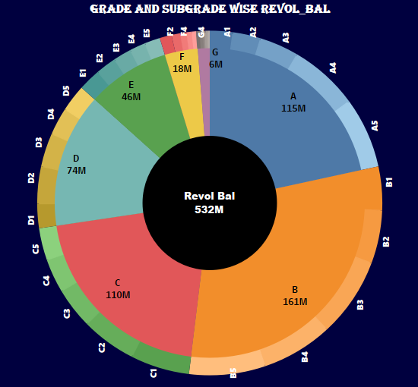
KPI 2: Grade and Subgrade wise Revolving Balance
OBSERVATIONS
At 161.31 M, B had the highest Sum of Revolving balance and was 23.95% higher than G, which had the lowest Sum of Revolving balance at 6.46 M.
﻿B accounted for 30.35% of Sum of Revolving balance.
﻿Across all 7 Grade, Sum of Revolving balance ranged from 6.46 M to 161.31 M.

Slide 5
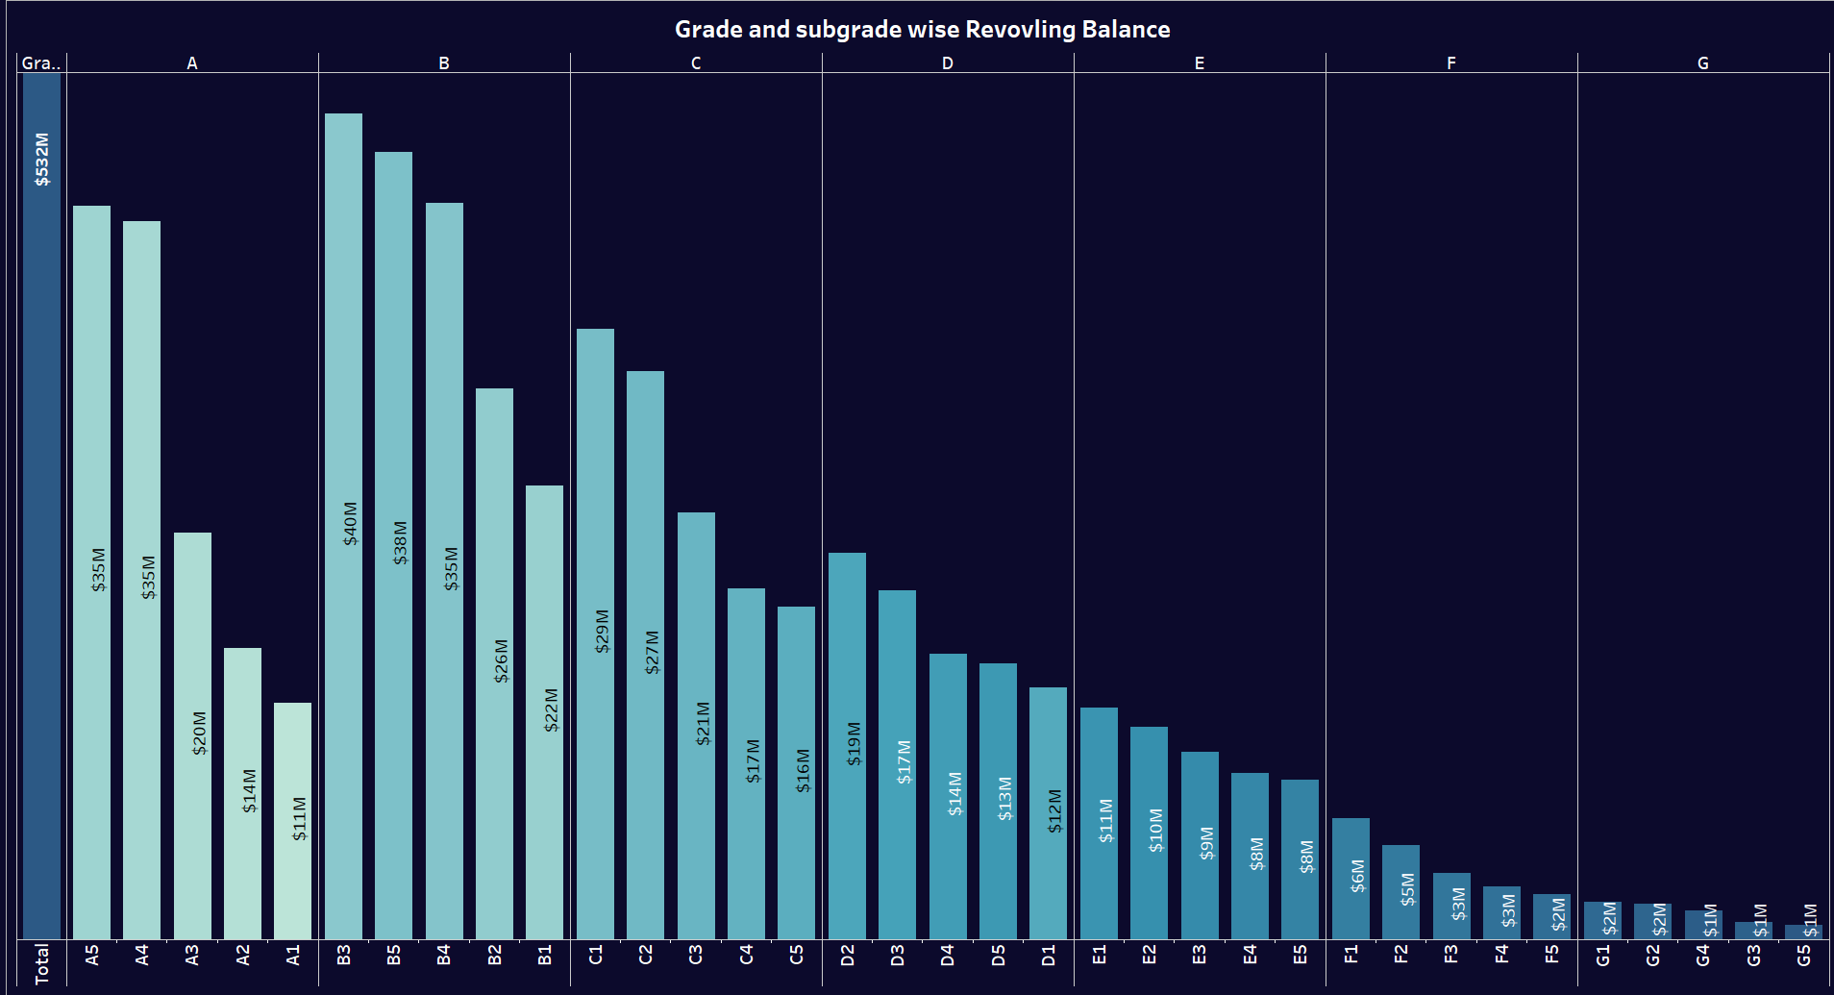
KPI 2: Grade and Subgrade wise Revolving Balance
OBSERVATIONS
﻿At 40M, B3 had the highest Sum of Revolving balance and was 56.62% higher than G5, which had the lowest Sum of Revolving balance at 701515.
﻿B3 accounted for 7.47% of Sum of Revolving balance.
﻿Across all 35 Sub grade, Sum of Revolving balance ranged from 701.52 K to 39.72M.

Slide 6
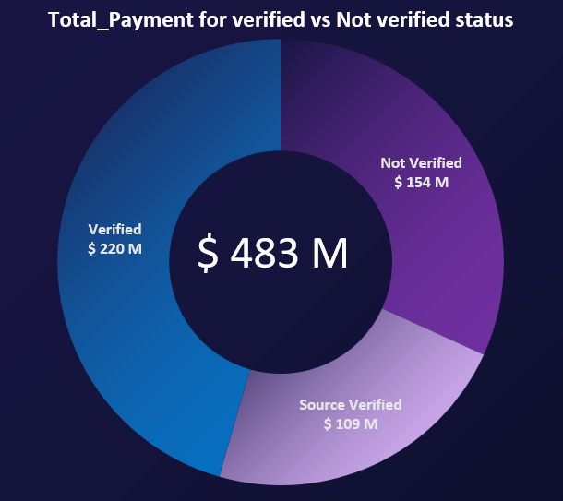
KPI 3: Total payment for verified status and not Verified status
OBSERVATIONS
Total Payment amount for verified is 68% and not verified is 32%
One of the factors for the highest verification is customers employment length
Debt-to-income-ratio is slightly high for verified compared to Not verified

Slide 7
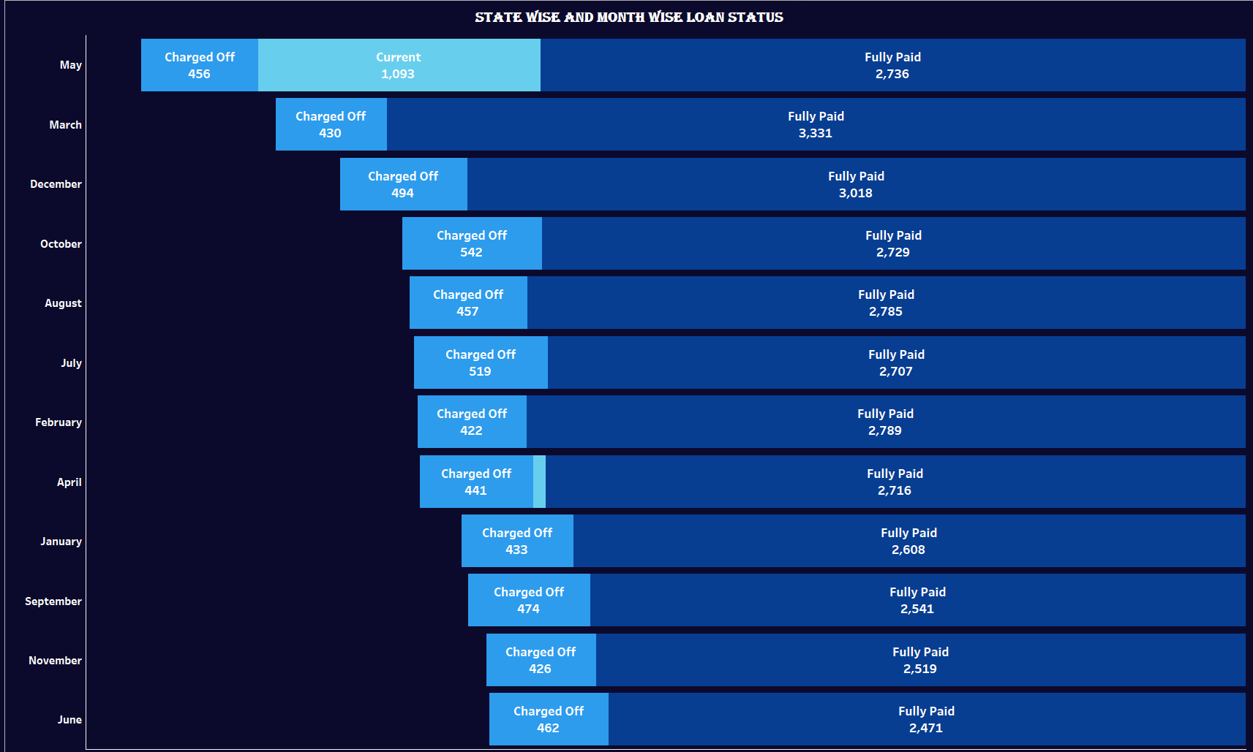
KPI 4: State wise and month wise loan status
OBSERVATIONS
In March month Fully paid is 88% and less charged off with 12%
Factors Affecting might be the end of the Fiscal year
In May month Fully paid is 63% the difference is almost 24% from March

Slide 8
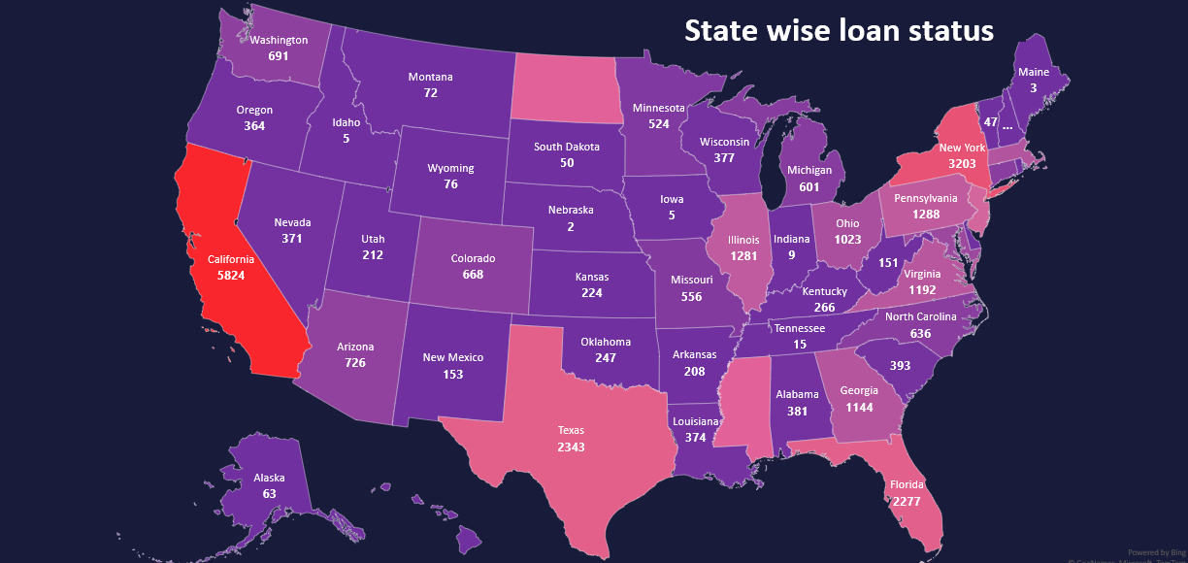
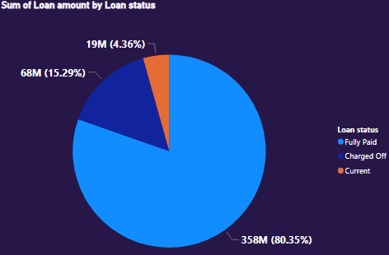
KPI 4: State wise and month wise loan status
OBSERVATIONS
California is the state with highest customers with 7099 i.e 17.87%
Maine has lowest customers with count of 3
Maine, lowa, Indiana are the 3 states loan status is Fully paid
Nebraska ,Nevada are charged off with 60% and 21.7%
As we can see in the graph Majority of our loans are fully paid .
And we also realize We have Charged off a lot of loan which raises concern as we might be facing few issues to verify the right customers

Slide 9
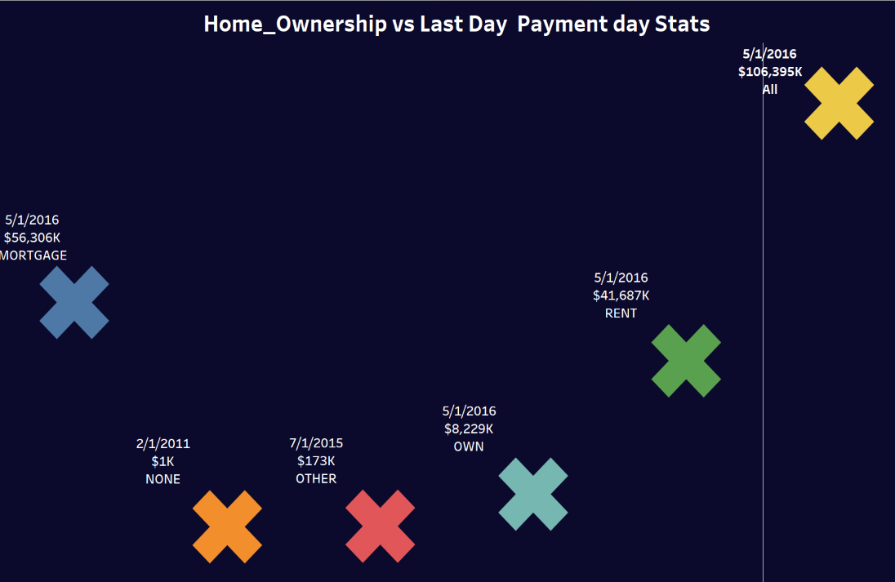
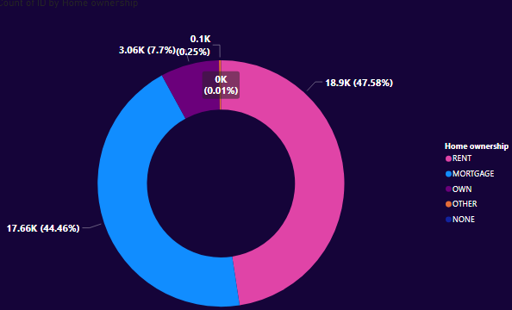
KPI 5: Home ownership vs Last Payment date
OBSERVATIONS
For the Mortgage last payment was done on 5/1/2016 which is higher than other type of home ownership which is at 56,306K
Then followed by the Rent type with 41,687K on 5/1/2016
The lowest amount of payment done by None type of Homeownership which is on 2/1/2011 with 1K
44.46% of our customers are living in mortgage.
47.58% of customers are living in rent.
Only 7.7% of companies Customer have their own home
And for the other 0.25% of customer are living.

Slide 10
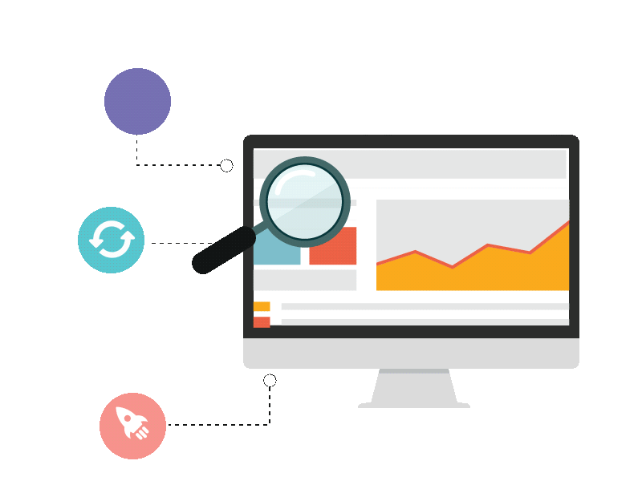
Observations
Reach
Company have Expanded to major US states and cities that boosts customer acquisition.
Data Clarity
Company have categorized customers for loans, and decide interest.
Safety
The company averages a DTI index of 13% which is well below the recommended average of 35% which is good

Slide 11
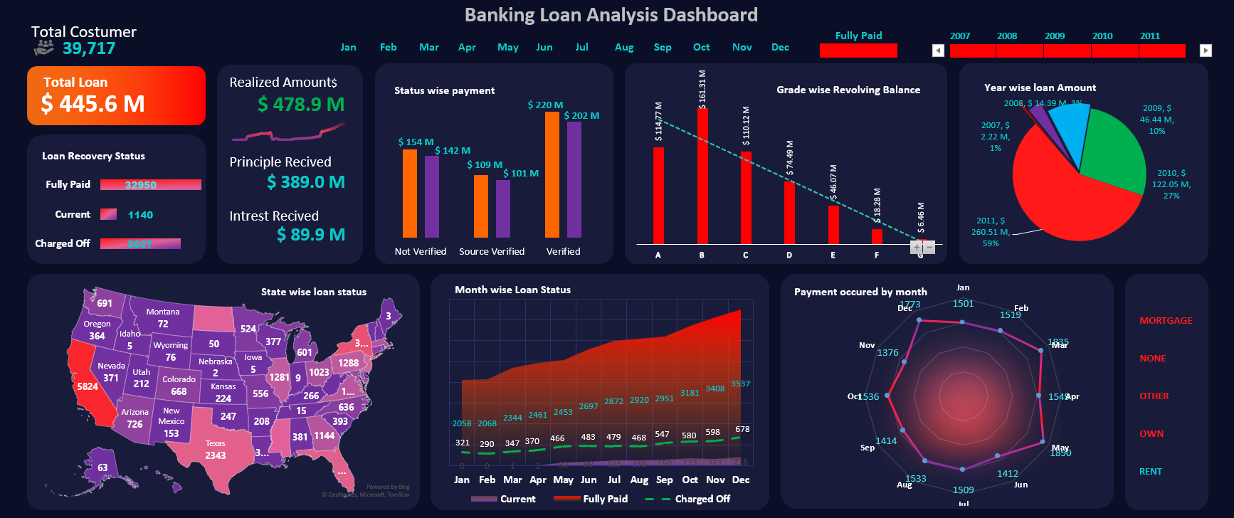
Excel Dashboard

Slide 12
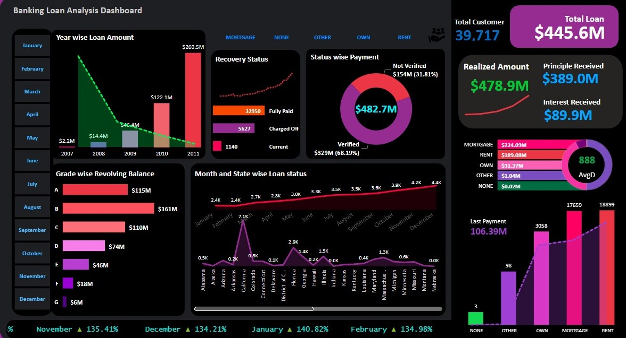
Power Bi Dashboard

Slide 13
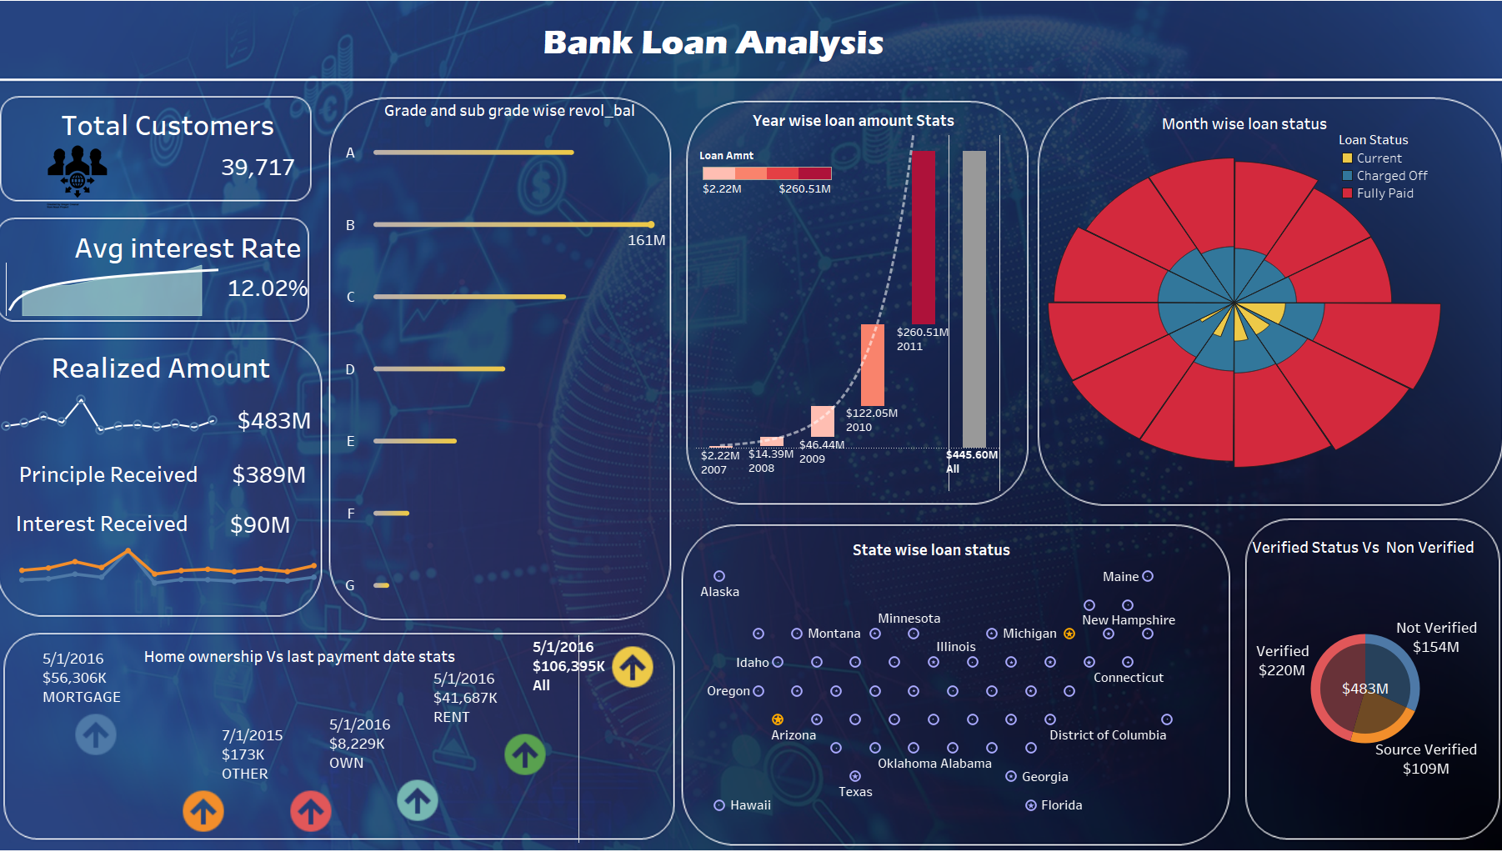
Tableau Dashboard

Slide 14
RECOMMENDATIONS
Maximize of loan Amount
Improving Revolving Balance
Customer Relationship
Introducing New product for purpose category
Ex : Film Financing ,
Investment Stock Purchases
Music Pursuits
Advertising campaigns to promote New loan Products
Strengthen relationships with existing customers by offering special interest rate For new loan Products
Max Credit limit is 35000 so by increasing the credit limit Revolving Balance also increases
Introducing zero-interest balance transfers, cashback rewards, or bonus points low-interest for specific purchases
marketing campaigns to reach specific customer
Company have multiple branches around the major states yet the customer count is not increasing try better marketing strategy should be the focus otherwise the company have to shut non performing establishments
More than 40 % of the customer are not verified it should reduce the non verified customer count by adding few customer relationship workshops and desks

Slide 15


Challenges
Importing the data to other tools
After the first meeting We were finding it difficult to load the data to tools like SQL and Connecting the SQL to Power Bi and Tableau but after researching a lot on the web we found multiple ways to do the task in hand.
Understanding the Data
As most of us were not familiar with the banking terms like DTI, Last Credit Line , Revolving Balance it tool us few days to research the topics to understand the data properly after which we could annualize the data .

Slide 16
What we learned ?
Connecting Data With other Tools
In this Project we had one excel File and one csv file and this project taught us multiple ways to connect the data with tools like SQL, Power BI, Tableau
Real World Application
Next This Project taught us how to apply the things we had learned in the classroom in an actual way.
Details Matter
Story Telling is Everything
Further more, Things like Alignment of a graph colour coordination things that we take for granted this project taught us how important that can be.
Last But Not Least, You can have one of the greatest dashboards with the best tools but if you can not convey your message to the other person it does not worth anything.

Slide 17


Thank You !

